Slide 1
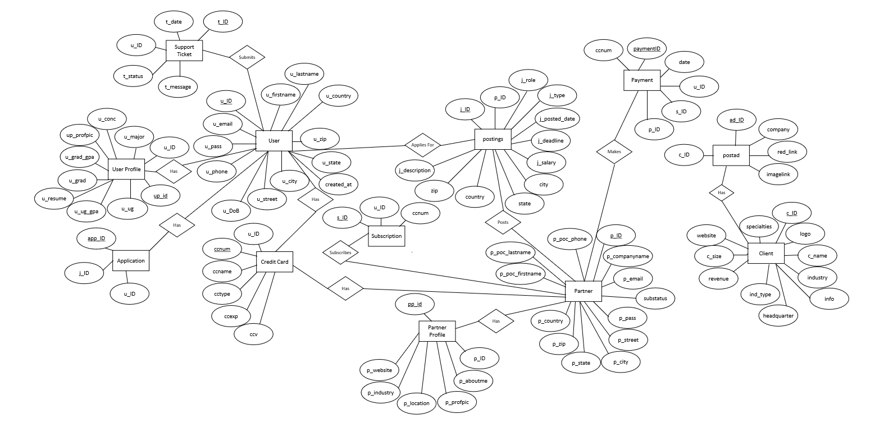
Conceptual ER Diagram – R2
Team 1
Jobster

Slide 2
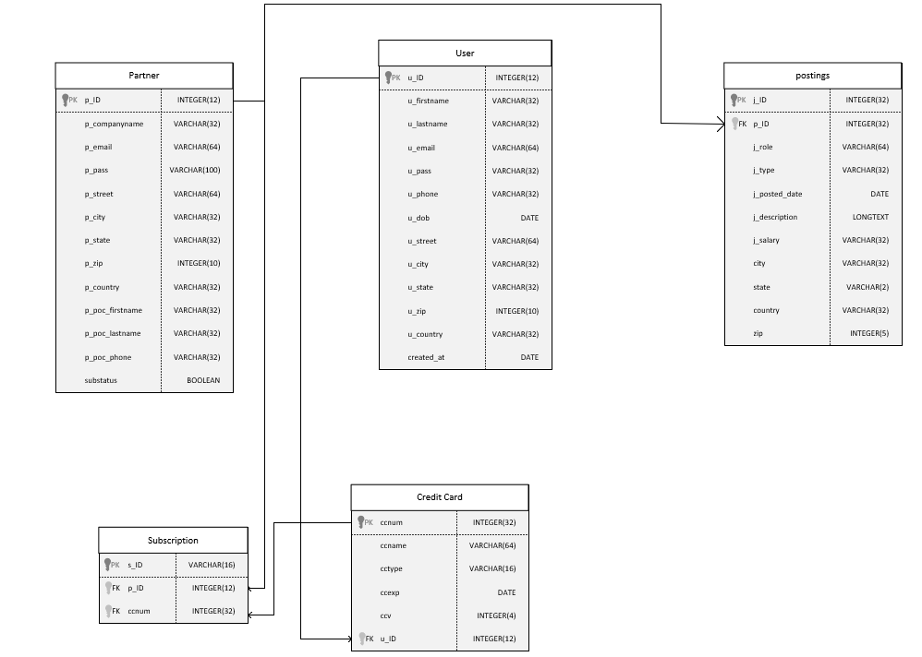
Logical ER Diagram R2
Team 1
Jobster

